Slide 1


TechLab Workshop
主讲人：向阳
时间：2021.02.22

Slide 2

Internal Training
Self-Intro
Education
Beijing Foreign Studies University Sept 2017 – Jun 2021
Bachelor of Arts in English Language & Literature
Peking University Sept 2019 – Jun 2021
Bachelor of Economics
Northeastern University Sept 2021 – Jun 2024
Master of Science in Computer Science
Skillset
Python, SQL, STATA, SPSS
Related Experience
Giance Technology Data Analytic Intern
PKU Research Assistant
BFSU Gender and Society Final Thesis
生活照

Slide 3
OUTLINE
Internal Training
What is Github?
Repositories
Explore
Useful Repo sharing

Slide 4
Part One
What is Github?

Slide 5
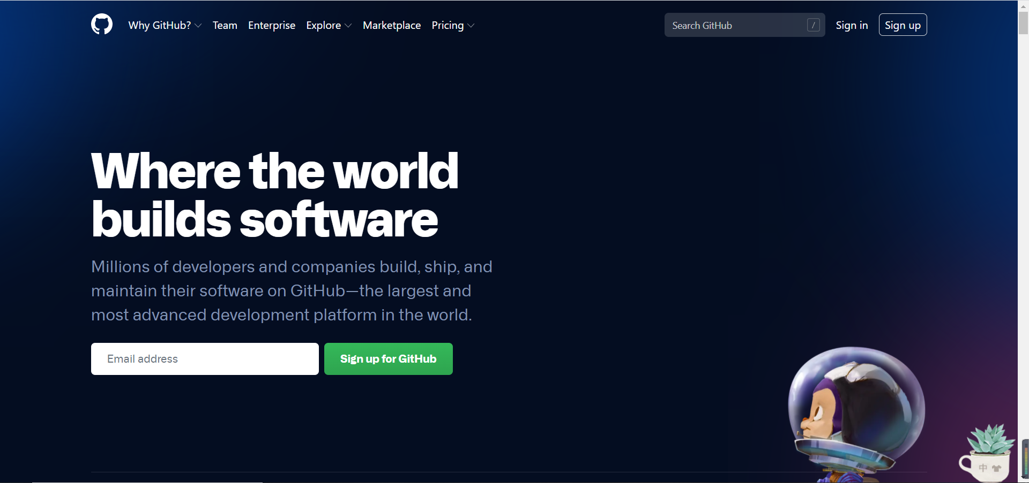
What is Github
Internal Training
Github是一个基于Git的代码托管平台，付费用户可以建私人仓库，我们一般的免费用户只能使用公共仓库，也就是代码要公开。(Github简明教程)

Slide 6
Part Two
Repositories

Slide 7
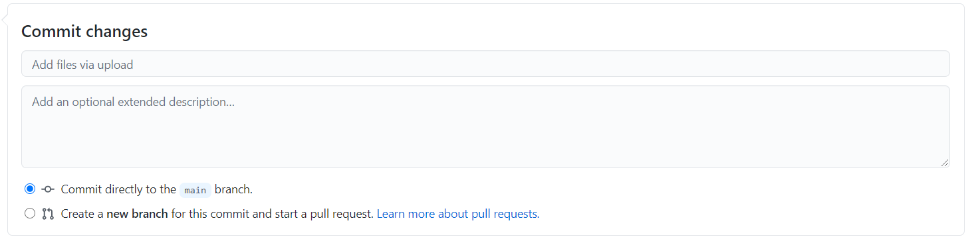
Repositories
Internal Training
Create a new repository
README.md
Upload files
Branch, pull requests, etc.
为什么要维护自己的Github？
Codes/Projects Review
Job Interview

Slide 8
Part Three
Explore

Slide 9
Explore
Internal Training
Search
Numpy stars:>3000
Pandas forks:100..30000
Python&jupyter
Awesome+…
Fork
Star

Slide 10
Part Four
Useful repo sharing

Slide 11

Useful repo sharing
Internal Training
Basics:
Python-100-Days
Free-python-games
Libraries:
100-pandas-puzzles
Numpy-100
Data:
Awesome-spider
Learn_python3_spider

